Slide 1

SPM Online Review
G4T4
PM: Tsang Bao Xian
Casper Lim Zhi Xin
Tricia Tan Li Lin
Ong Yan Ning
Loh Xiao Binn

Slide 2
IS212 Software Project Management
Application Demo
&
Progress Update
Project Manager: Tricia Tan
PM: Tsang Bao Xian
Casper Lim Zhi Xin
Tricia Tan Li Lin
Ong Yan Ning
Loh Xiao Binn

Slide 3

Functionalities
Wiki Question | Answer
Do you plan to drop/add any functionalities? | No
Do you plan to use any PHP frameworks? | No
Did you manage to finish login + 1 functionality? | Yes
What functionalities have you finished? | Login, add bid, bootstrap, [NEW] update bid, delete bid, JSON web service (partial), round 1 clearing logic (partial)
What is the IP address & admin password for your cloud deployment? | IP Address: 54.169.210.219 Admin password: @dm1in5PM

Slide 4

Schedule Overview
Weekly Meetings on Tuesdays and Fridays.
Task set on Friday has deadline on Tuesday → 4 Working Days
Task set on Tuesday has deadline on Friday → 3 Working Days

Slide 5
Planned Iterations status: On schedule
Iteration | Task | Start Date | End Date
1 | Login, Add bid, Bootstrap Functionality | Monday of Week 5 | Sunday of Week 6
2 | Drop bid, Slides for PM review, Web service, Update bid | Monday of Week 7 | Thursday of Week 9
3 | Rounds, Drop section, Dumping | Friday of Week 9 | Thursday of Week 11
4 | Deploying to AWS, UAT, Check UAT results, testing, debugging, redeploy | Friday of Week 11 | Thursday of Week 13
5 | Prepare Final presentation slides | Friday of Week 13 | Sunday of Week 14

Slide 6
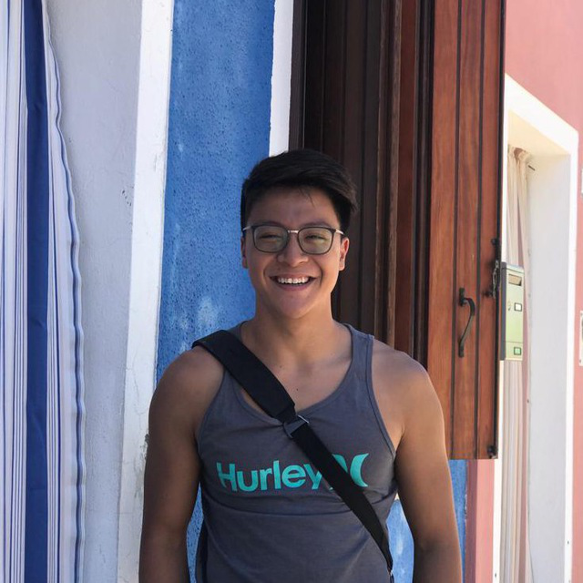
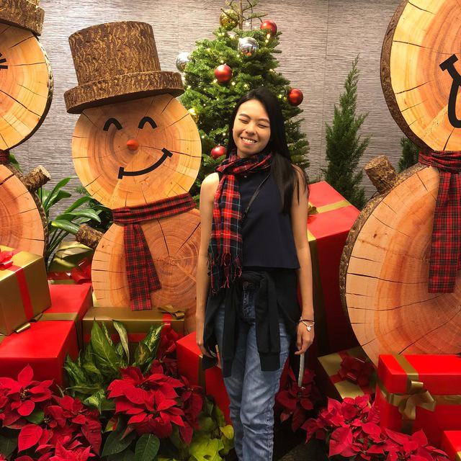
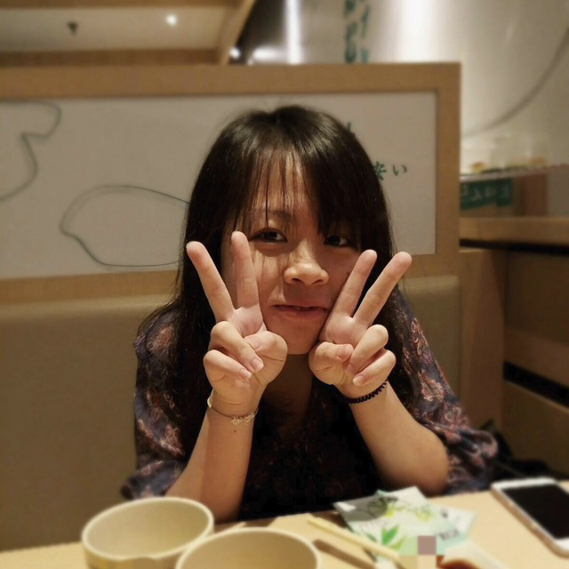
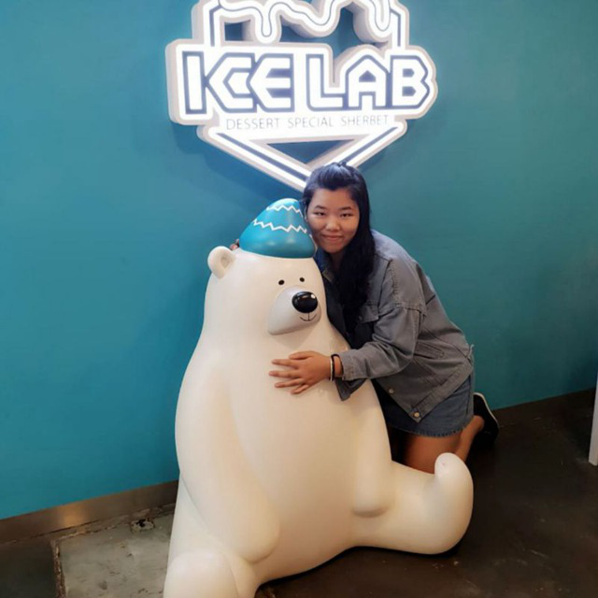

Roles & Task Allocation
d
Bao Xian
Coder
Loh Xiao Binn
Coder
Tricia Tan
PM, Coder
Yan Ning
Coder
Casper Lim
Coder

Slide 7
Milestones
27 September – End of Iteration
3 October – PM review
13 October – End of Iteration 2
17 October – Application Demo
27 October – End of Iteration 3
31 October – User Acceptance Test
10 November – End of Iteration 4
17 November – Final submission
21 November – Final Presentation

Slide 8
PM in-charge of Milestones
Milestone | PM
End of Iteration 1 | Bao Xian
PM Review | Bao Xian
End of Iteration 2 | Tricia
Application Demo | Tricia
End of Iteration 3 | Celine
User Acceptance Test | Celine
End of Iteration 4 | Casper
Final Submission | Casper
Final Presentation | Yan Ning

Slide 9
Buffer Time
Deadlines set at next meeting
Taking over/ Helping each other at meetings if any of us face any difficulties
Use Meeting time as buffer to debug

Slide 10
2
6
1
2
1
Testing & Debugging
3
6
7
Round 1 logic
8
9
Testing & Debugging
1
9
Add bid validation
2
3
Update bid
5
Iteration 2
1
2
4
5
6
6
7
8
9
9
1
6
2
Delete bid (JSON)
3
2
7
JSON checker
3
4
Update bid (JSON)
5
3
3
5
1
6
7
1
8
4
1
1
Authentication
4
4
Create dump table
4
1
12
1
Deployment
11
12
Testing & debugging
10
1
11
Integration
10
4
4
7
3
7
10
10
11
11
12
12
5
1
Testing & Debugging
5
5
1
Create dump (user)
5
2
13
1
Working prototype
11
13
PM review slides
12
5
5
8
3
8
13
1
13
13
13
14
2
App demo, update process
6
3
1
14
Bootstrap
8
9
Testing & Debugging
9
6
8
9
9
14
14
End

Slide 11
Critical Path (Iteration 1)
Start
Read Wiki
Schedule Iteration 1 tasks
Plan other Iterations
Create Login Page with Welcome Message
Create project database & Complete authentication
Test
Login Page
Test
Iteration 1
Test
Bootstrap
File validations
Add .csv values into database
Create Bootstrap interface
Create addBid page
End

Slide 12
Critical Path (Iteration 2)
Start
AWS Deployment
Validations (addBid, Bootstrap)
Drop Bid
JSON Web Service
Update Bid
Online Review
Preparation
(Milestone)
Iteration Deployment
Iteration Testing
Iteration
Integration
End

Slide 13
Critical Path (Iteration 3)
Start
Rounds
Drop Section
JSON Dumping
Iteration Integration
Iteration Testing
UAT
Preparation
(Milestone)
Iteration Deployment
End

Slide 14
Critical Path (Iteration 4)
Start
Integration
Web Application
Testing
Web Service Testing
AWS Deployment
Final Submission
Preparation
(Milestone)
End

Slide 15

Bug Metrics
Wiki Question | Answer
What is the current value for the metric? | ??
Did you have to take any action according to your mitigation plan? | Debugging sessions are arranged when iteration points > 10 Yes, debugging session was carried out during group meetings

Slide 16
Iter2: Paired Programming Rotation Plan
Functionality | Paired Programmer | Paired Programmer
Update Bid | Tricia Tan | Yan Ning
Drop Bid | Casper Lim | Xiao Binn
JSON Web Service | Bao Xian | Casper Lim
Round Clearing Logic | Tricia Tan | Xiao Binn

Slide 17
Thank You

